Slide 1



Anaerobic Digestion for Waste Management and Bioenergy Production
Dr. Byong-Hun Jeon
Professor
Department of Earth Resources and Environmental Engineering
Hanyang University, Seoul, South Korea
Techniques of New Energy and Environment
HYU-JLU-FCU Joint Symposium
2021-07-28
Notes:
Good morning everyone! This is Byonghun Jeon from the Dept of Earth Resources and Environmental Engineering at Hanyang University.
I would like to draw attention on “Anaerobic digestion for waste management and bioenergy production” for about 15 minutes.

Slide 2
Contents
1. Introduction
2. Methods
3. Results
4. Conclusion
Notes:
I will get you Introduction through Conclusion.

Slide 3
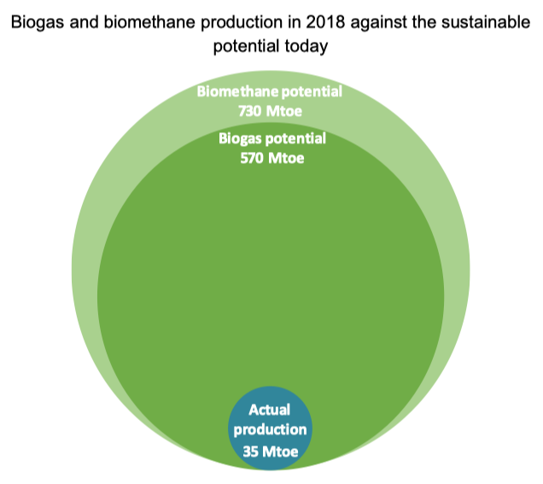
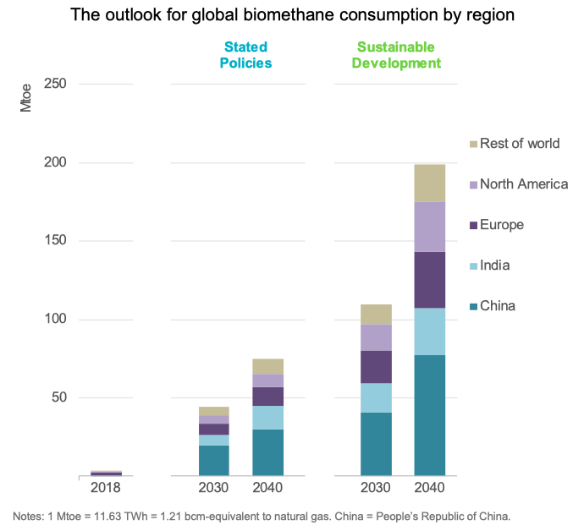
1. Introduction
Bioenergy production from organic wastes
Source: tn.gov
Source: IEA (2020)
The worlds’ cities are generting 1.3 billion tonnes of solid waste per year, amounting to a footprint of
1.2 kg per person per day
Municipal waste generation is expected to rise to 2.2 billion tonnes by 2025 with approximately 46%
organic contents (Ranieri et al., 2018)
More than 90% of municipal solid waste (MSW) in cities and towns are directly disposed in landfills and
open dumps (Amritha and Anilkumar, 2016)
Utilization of organic waste for bioenergy generation is a promising and sustainable approach to combat
the rising environmental, economic, and technological issues related to GHG-emitting fossil fuels
Notes:
As the worldwide development, industrialization and population growth continues, enormous generation of wastes from diverse sources are being a fast-growing global environmental problem. Such wastes are still not being recycled but are mostly being disposed in landfills and open dumps, thus severely affecting the Earth environment. One of the most convincing strategies to mitigate such issue is the utilization of organic waste, including bioenergy production. Through such process, waste materials are reduced, and at the same time, bioenergy is produced that can supply fuel demands to mitigate greenhouse gas emissions.

Slide 4
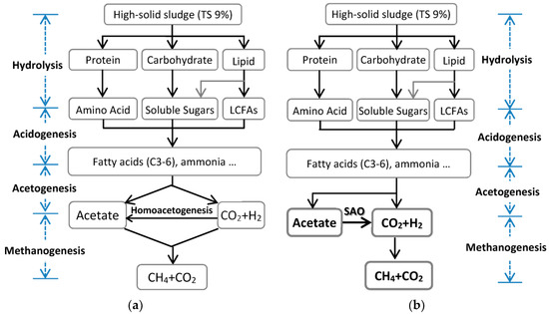
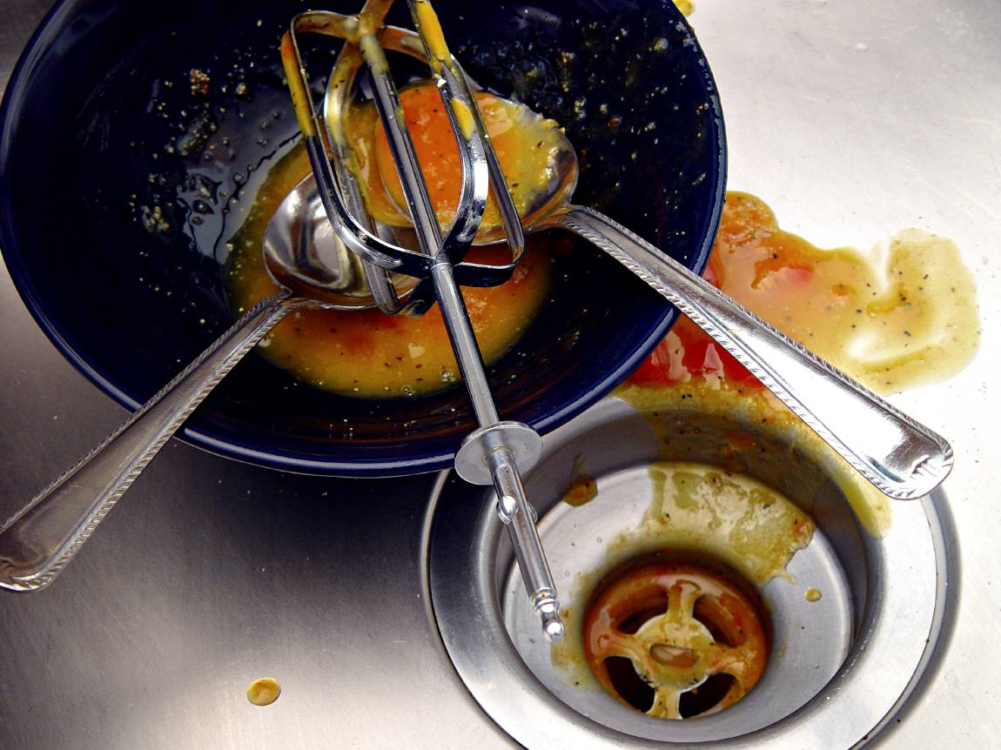
1. Introduction
Anaerobic digestion & high-VS organic wastes (e.g., FOG)
  Bioenergy feedstocks
  Wood residues
  Crop wastes
  Animal wastes
  Municipal Solid Waste
  Food waste
  Fat, oil and grease waste
  Industrial wastes
What are the components of FOG?
  Fats : Chains of fatty acids found in food
  Oils : Fats that are liquid at a certain temperature
  Grease : Composed of a combination of fats and oils
Fig. Anaerobic digestion of complex organic compounds:
acetoclastic methanogenesis (a), hyderogenotrophic methanogenesis (b)
Anaerobic co-digestion is a process of simultaneous digestion of two or more substrates in order to
overcome the drawbacks of mono-digestion and to improve plants’ economic feasibility
High-VS (volatile solid) organic wastes such as fat, oil and grease (FOG) has potential to increase the
efficiency of biogas production through anaerobic co-digestion
Co-digestion of FOG has higher methane yield potential per g VS, which can generate 250–350% greater methane (Affes et al., 2017)
Notes:
One of the most promising renewable bioenergy sources is biogas, which is produced from anaerobic digestion as the anaerobic microbes break down the waste biomasses. It has been gaining a big momentum with the immediate global need to mitigate the carbon emissions and is only expected to rise in the near future. Anaerobic digestion can be optimized in the form of co-digestion with different types of organic wastes, and one of the best co-substrate to be considered is the oily portion of food waste that has higher amount of energy stored in it. But due to its properties it often causes process failure in typical settings, so engineering the AD process with FOG co-digestion is necessary to harness its potentials.

Slide 5
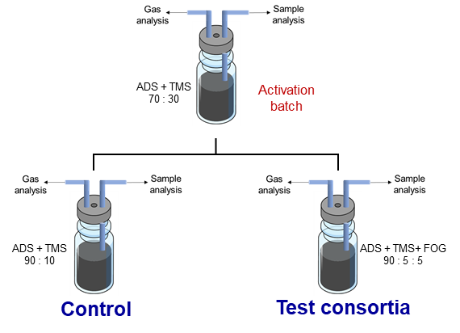
2. Methods
Development of FOG degrading microbial consortium
Methods for development of consortium
Lab scale anaerobic bottles in fed batch process.
ADS was activated in 1st batch with combined substrate (PS + ACS at 60:40 ratio).
Activated ADS was loaded with FOG (5% v/v).
pH was maintained at 7.0 and at temperature at mesophilic condition.
Multiple batches will be run to get a different microbial community adapted for higher FOG loading.
Parameters consider during development of consortium
pH
Biogas: H₂, CO_{2,} CH₄
Intermittent microbial dynamics (metagenomics analysis)
Notes:
The most important process constituent of anaerobic digestion is the microbes that carry out the complicated metabolization process from hydrolysis to methane generation. By using specific acclimation strategy such as the one demonstrated here, specific microbiota that excels in the degradation of desirable substrates can be obtained, even working in conditions where typical microbes would fail.

Slide 6

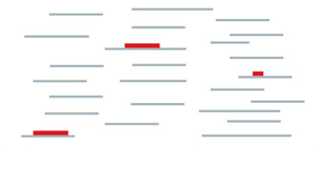
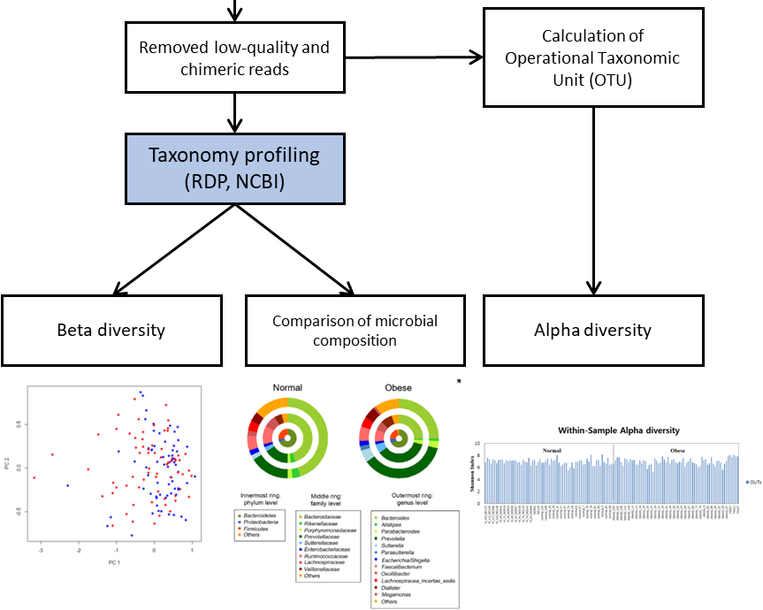

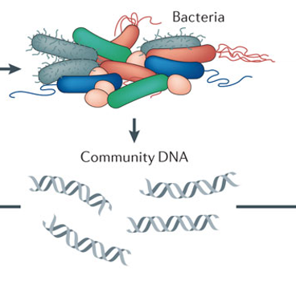
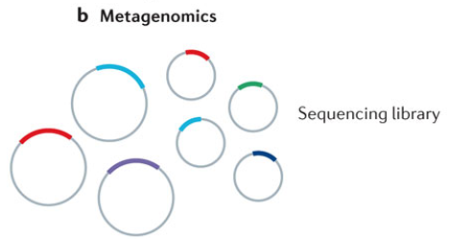
2. Methods
Metagenomics analysis for microbial dynamics studies
Bioinformatics Analysis
Fig. The retrieval of samples at regular
time intervals from the anaerobic digester for the metagenomics analysis.
Metagenomics Analysis
Notes:
The specialized microbiota obtained from acclimation process is further analyzed by cutting-edge molecular biology tools such as HTS (high-throughput sequencing) to understand the composition and characteristics of the diverse types of microbes present in the reactor. First, the community DNA from the prokaryotes, that includes bacteria and archaea, are extracted and subjected to HTS. The analyzed DNA information is subsequently produced as a type of big data and further processed with in-depth bioinformatics analysis techniques.

Slide 7
3. Results
Characterization of FOG
Properties |  | FOG
Proximate analysis | Total solids (wt.%) | 95.40 ± 0.11
 | Volatile solids (wt.%) | 96.80 ± 0.12
 | Ash (wt.%) | 3.05 ± 0.11
 | Fixed carbon (wt.%) | 0.15 ± 0.01
 | Total carbohydrate (wt.%) | ND
 | Total protein (wt.%) | 7.15 ± 0.44
 | Total lipid (wt.%) | 94.39 ± 4.67
 | COD (%) | 330.9
Ultimate analysis | Total carbon (wt.%) | 77.51 ± 0.12
 | Total nitrogen (wt.%) | 1.14 ± 0.07
 | Total hydrogen (wt.%) | 16.32 ± 0.34
 | Total sulfur (wt.%) | 1.48 ± 0.15
 | Total oxygen (wt.%) (by difference) | 3.55 ± 0.20
 | C/N ratio | 68.29
Physical properties | pH | 4.65 ± 0.01
 | Calorific value (kJ g‾¹) | 39.47 ± 0.03
FT-IR Spectrum of FOG
FT-IR analysis revealed aliphatic chains, and palmitic/oleic acids presence in FOG
Characterization of FOG showed very high amounts of TS & VS
Property of FOG is reported to be universal, in terms of biomethanation potential
(Kobayashi et al., 2017)
Notes:
The FOG used in the anaerobic co-digestion process is derived from food waste stream, which is the oily portion extracted from it. From the analysis it was revealed that the FOG contained diverse types of fatty acids, containing high amounts of palmitic and oleic acids, which is no surprise as it is from human food waste. More importantly, from the physicochemical analysis of FOG it was found to be extremely rich in TS & VS content, which, theoretically, can mostly be converted to biomethane if utilized by the microbes under the right conditions.

Slide 8
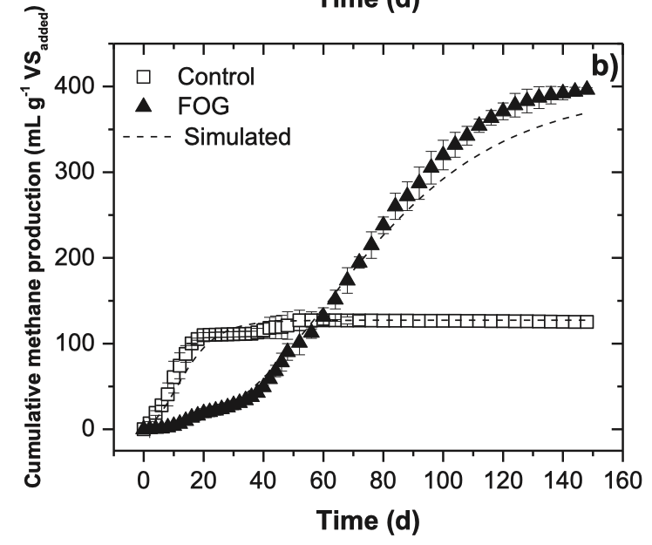
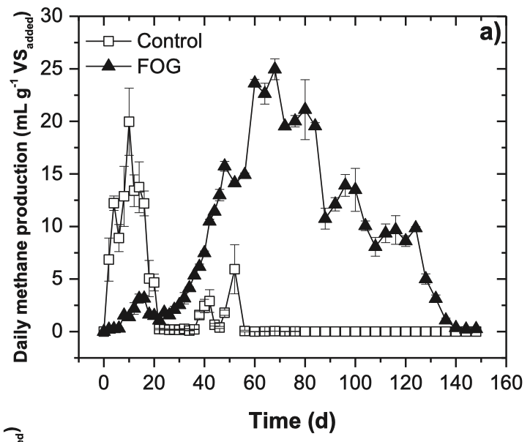
3. Results
Microbial Acclimatization to FOG: BMP & Batch test
Wild microbiome strains subjected to high concentration of FOG substrate
Biological methane potential (BMP) test revealed acclimatizing properties of AD microbiome
Initially (up to 20 days), the FOG containing reactor failed to produce biogas, but after prolonged periods of reaction the FOG were utilized successfully
Acclimatization to this higher FOG loading led to better biomethanation performance per added VS
Notes:
To develop the acclimated consortium of the AD process, the normal microbe consortium from wastewater treatment plants were subjected to very high amount of FOG, naturally incurring heavy process inhibition in initial stages. But with the optimized acclimation condition the FOG was slowly degraded over time, indicating that the composition of the consortium, or microbiome changed over time to be degrading the FOG efficiently. Interestingly, the acclimated consortium has better methane production per added volatile solid of the substrate, showing the higher process efficiency of co-digestion over mono-digestion.

Slide 9
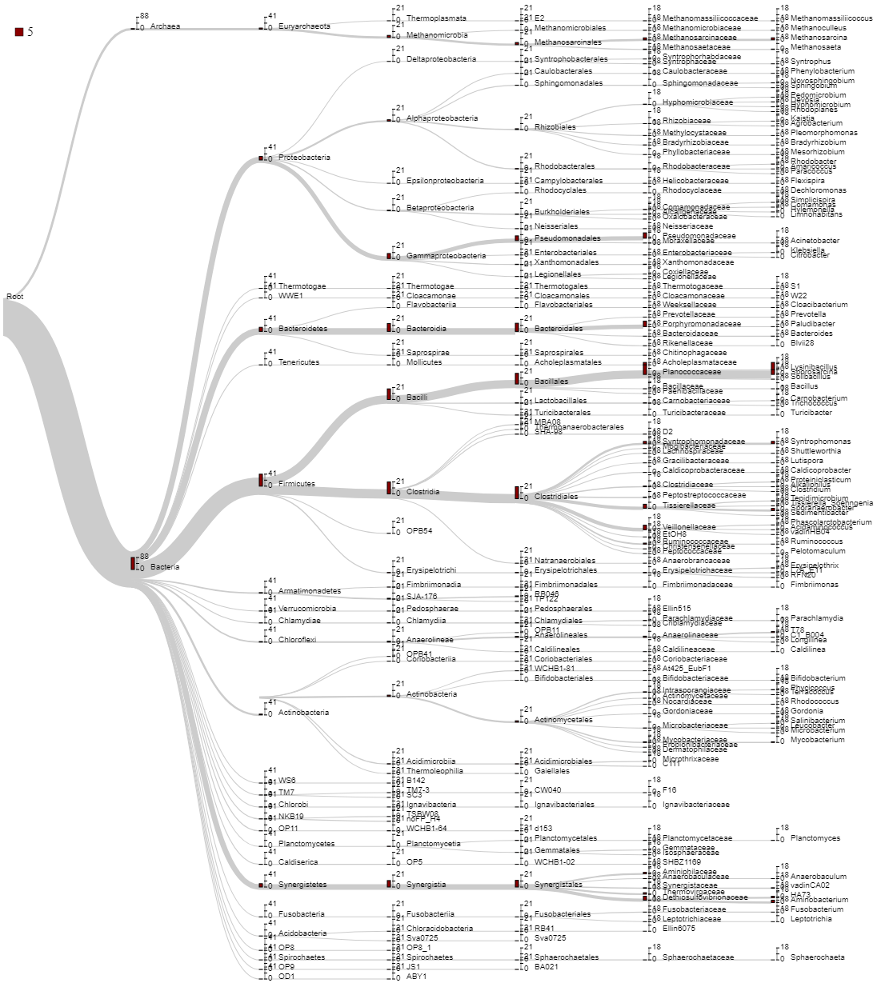
3. Results
Microbial Communities in FOG Co-digestion
Methanosaeta,
Methanosarcina
Methanogenesis
Syntrophus,
Acinetobacter,
Bacteriodes,
Lysinibacillus,
Sporosarcina,
Syntrophomonas,
Clostridium,
Aminobacterium
Hydrolysis,
Acidogenesis,
Acetogenesis,
LCFAs oxidation
Fig. The dendrogram showing the tree of several different microbial communities obtained during co-digestion of FOG.
Notes:
Metagenome analysis of the acclimated microbiome with HTS technology and subsequent bioinformatics analysis yielded this hierarchical dendrogram of the microbial taxa present up to the genus level. From this taxonomic overview, the specific microorganisms related with anaerobic digestion process were appropriately found, first with these blue bacteria from the phyla Bacteroidetes, Firmicutes and Fusobacteria that are responsible for the initial biodegradation pathways of hydrolysis and acidogenesis. The archaea phylum of Euryarchaota that performs the last important bioprocess of methane generation, that is called methanogenesis, was also found and is shown in brown.

Slide 10
3. Results
Changes in microbial dynamics: Taxonomy
Fig 1. Changes in relative abundance
of the phyla during batch co-digestion
of FOG.
The phylum level analysis showed that, Proteobacteria were dominating (43%) before the addition of FOG.
The dominance of Proteobacteria was decreased with simultaneous increase of Firmicutes, Bacteriodates, Synergistetes and Euryarchaeota during the digestion of FOG (Fig. 1).
Among 40 dominant genera in FOG co-digestion, the species assigned to Syntrophomonas genus were increased to ~12% during LCFA degradation, which substantiates the importance of Syntrophomonas species in LCFA degradation in anaerobic co-digestion (Fig. 2).
Fig 2. Heatmap of microbial communities at different time intervals (0 to 120 d). The Y-axis in the heat map shows the clustering of top 40 abundant genera. The color intensity of scale indicates relative abundance of each genus.
Notes:
The samples from the acclimation process were further analyzed with taxonomic analysis. From the broader phylum level analysis of the samples from day 0, 40, 80 and 120, it showed that Proteobacteria was the dominating phylum before FOG was added. However, as the acclimation to FOG was continued the dominance of Proteobacteria was decreased, with simultaneous increase in the abundance of phyla such as Firmicutes, Bacteriodates, Synergistetes and Euryarchaeota, showing the dynamic change in constitution of the microbiome along the process. In the more in-depth genus level analysis, among the 40 dominant genera Syntrophomonas was increased during the active degradation of FOG, that excels in the degradation LCFA from the hydrolyzed constituent of FOG.

Slide 11
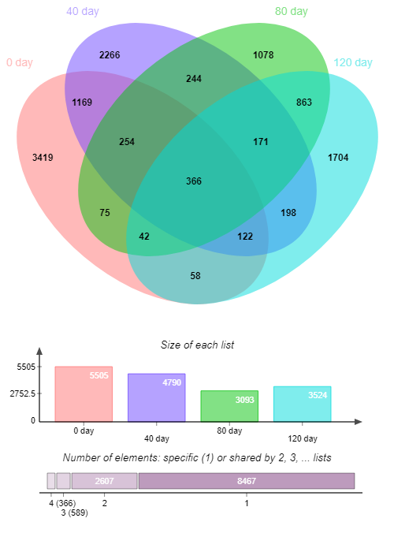
3. Results
Changes in microbial dynamics: Statistics
Distinct divergence
Distinct divergence
Fig. Multivariate analysis (β diversity) showing unconstrained PCoA analysis of weighted UniFrac distances based on Bray-Curtis dissimilarity distance matrix (a), Nonmetric multidimensional scaling (NMDS) plot ordinated using Bray-Curtis dissimilarity distance matrix (b), neighbor joining clustering (c) and Correspondence analysis (CA) plots based on OTU sequence counts in the samples collected at different phases (0 to 120 d) (d).
Fig. Metagenome comparison using the Venn diagram. It depicts the number of OTUs shared or specific for four samples.
Maximum number of OTUs were shared among the samples retrieved at 0 d and 40 days. As the digestion time increased, the number of common OTUs were decreased showing less common OTUs in between 0 d and 120 d.
The multivariate statistical analyses also confirm the diversity between the samples. It showed that sample recovered at 0 d had completely different microbial diversity compared to others.
Notes:
In the metagenomic statistical analysis of the samples, the number of OUT (operational taxonomic unit) indicates the microbial diversity of the sample. From the acclimation samples, day 0 and 40 showed higher OTU number, while day 80 and 120 showed relatively lower numbers. It shows the ‘all-purpose’ style constitution from the initial microbiome turning into a highly specialized symbiosis of the microbes that readily degrades high concentrations of oily matter. While the number of OTU was similar between day 0 and 40, principal coordinates analysis (PCoA) of the samples, that shows the level of similarity derived from select major components, together with other multivariate statistical analysis revealed that day 0 sample had completely different microbiome from the later acclimated samples, showing the impact of acclimation in the microbiome.

Slide 12
3. Results
FOG co-digestion significantly alters methanogenic community
Table. Characteristics of Methanosarcina and Methanosaeta. De Vrieze, J. (2014).
Most versatile methanogen
Fig. Community structure and dynamics of methanogenic archaea presented at genus level within the FOG codigester at different time intervals (0 to 120 d).
The dominance of Methanosaeta population at the beginning of the co-digestion was significantly took over by the population of Methanosarcina at the end of digestion
Species related to Methanosaeta are obligate acetoclastic methanogens which use acetate as substrate for methane production. In contrast, species related to Methanosarcina spp. are metabolically and physiologically most versatile methanogens which can produce methane using CO2, H2, methyl containing groups, and acetate
Methanosarcina is the prevailing acetoclastic methanogen at high acetate concentrations, while Methanosaeta becomes dominant at lower acetate concentrations
Notes:
The most drastic changes in the composition of microbiome was observed in the main actor of the anaerobic digestion, the methanogens. Although the methanogens, namely the phylum Euryarchaeota usually consists only less than two to three percent of the total microbes present in the anaerobic digestor responsible for the generation of methane, that is the final product of anaerobic digestion process for biogas production, making them highly important in the whole process. Initially, the Methanosaeta was dominant genus but was almost completely overtaken by the genus Methanosarcina genus. From the previous research available, it is known that Methanosarcina is more versatile methanogen with multiple pathways for methane production and higher activity in high acetate concentrations. It shows that the acclimation process enables such potent members from the initial microbiome to thrive, and maintaining them is the key in the operation of such high-load anaerobic digestion processes.

Slide 13
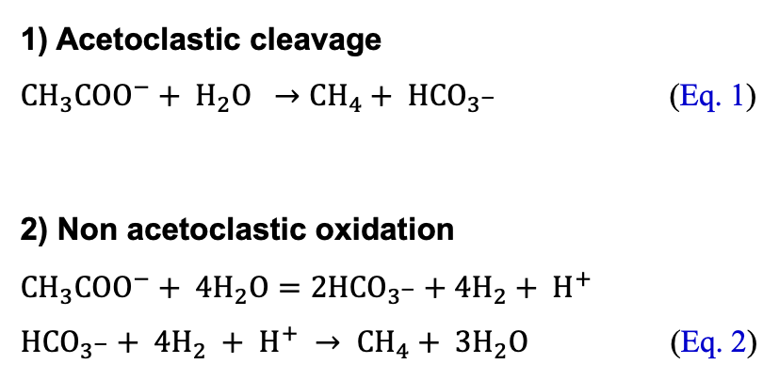
3. Results
Conversion of FOG to methane via acetoclastic pathway
Two methanogenic pathways from acetate have been identified.
1) Acetoclastic cleavage
${{CH}_{3}COO}^{−}+ H_{2}O →{CH}_{4}+ {HCO}_{3^{−}}$ (Eq. 1)
2) Non acetoclastic oxidation
$${{CH}_{3}COO}^{−}+ 4H_{2}O={2HCO}_{3^{−}}+4H_{2}+ H^{+}$$
${HCO}_{3^{−}}+ 4H_{2} + H^{+} → {CH}_{4}+ {3H}_{2}O$ (Eq. 2)
Acetoclastic methanogens
Methanosarcinaceae Methanosaetaceae
Syntrophic acetate oxidizers (SAOs)
Thermacetogeniumphaeum, Syntrophaceticusschinkii,
Tepidanaerobacteracetatoxydans, Clostridium ultunense,
Pseudothermotogalettingae
Hydrogenotrophic methanogens
Methanobacterium, Methanobrevibacter, Methanoculleus
Methanofollis, Methanolinea, Methanosphaerula, Methanoregula, Methanosphaera, Methanospirillum
The relative abundancy of well-known SAOs were extremely low or absent during the entire duration of co-digestion of FOG.
Low abundancy of SAOs and hydrogenotrophic methanogens and high abundancy of acetoclastic methanogens suggest methane generation was predominantly directed through acetoclastic pathways.
Notes:
Although there are three pathways of methanogenesis including methylotrophic pathway, in the viewpoint of engineering, hydrogenotrophic and acetoclastic pathways are major contributors in final biomethane production, and these two pathways were compared under the condition of FOG acclimation. In case of hydrogenotrophic methanogenesis, syntrophic acetate oxidizers act with hydrogenotrophic methanogens to form a symbiotic relationship. In the FOG acclimation condition, however, very low or null abundancy of syntrophic acetate oxidizers were found, indicating the dominant role of acetocalstic methanogenesis performed by Methanosarcina genus in high-efficiency anaerobic co-digestion of FOG.

Slide 14
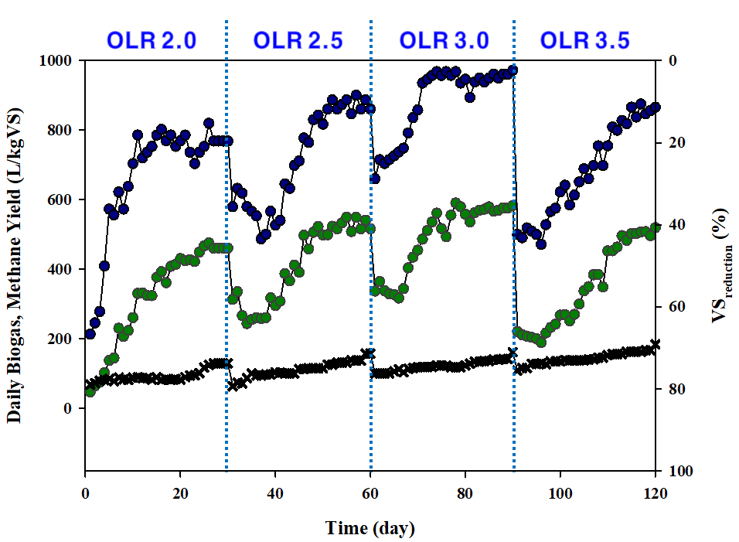
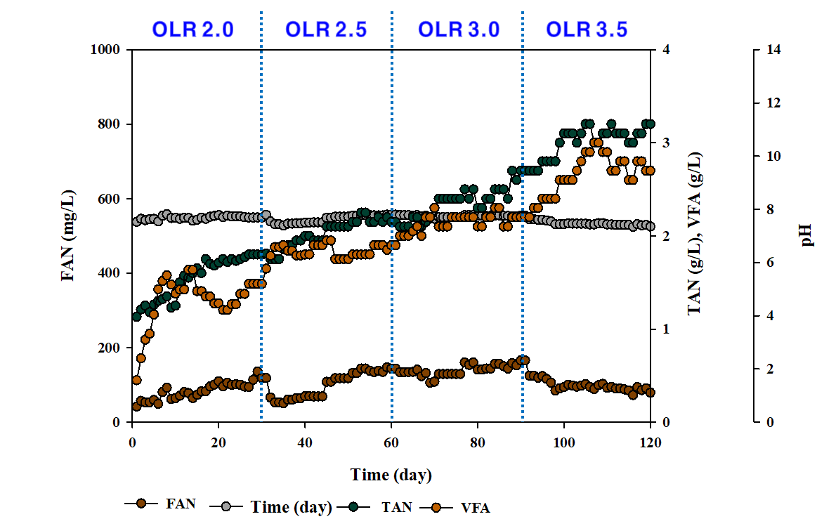
3. Results
Microbial Acclimatization to FOG: Lab Continuous Reactors
Biogas Yield
Methane Yield
FAN
VFA
TAN
pH
Operation of lab continuous reactors showed similar acclimatization patterns
Organic loading rate (OLR) was sequentially increased to reach up to 3.5 Kg VS/m³/day
At the beginning of each interval, biogas yield was decreased, but eventually reached steady state in higher yield, leading to more effective production of biogas
Notes:
With such findings, lab-scale continuous reactors were operated in the condition of co-digestion through the span of 120 days, using similar initial conditions with the addition of pretreated primary & waste-activated sludge as co-substrates. It showed similar acclimatization patterns along the increment of organic loading rate from 2.0 kgVS per meter cube per day to 3.5, showing decreased daily biogas production at the beginning of each interval, but eventually showing better yield through acclimation of the microbiome.

Slide 15
4. Conclusion
Anaerobic co-digestion of sewage sludge and FOG is an effective strategy to increase the energy consumption offset of WWTPs, with several plants around the world already in operation
Chemical/thermal/physical preatreatment of the substrates increases the properties fit for subsequent biomethanation, but cost-effective golden mean should be carefully pinpointed according to the actual scale and different conditions of each case
Extensive dosing of FOG (70% VS) initially deteriorated the ACoD performance; however, it gradually recovered and enhanced methane production by 217%: Drastic changes in anaerobic microbiome is observed under acclimatization to the FOG co-substrate condition
FOG addition led to a significant increase of acetogenic bacteria, such as Syntrophomonas, Sporanaerobacter and Propionispira which were linked with increases in methane production.
A trivial presence of syntrophic acetate oxidizers (SAOs) and hydrogenotrophic methanogens, and an extreme dominance of Methanosarcina suggest that methane generation during ACoD of FOG was predominantly directed through acetoclastic pathways
Such acclimatized microbiome is observed to be very effective on digestion of high-loading organic substrate, which is very promising in terms of biomethantion efficiency improvement in many different situations, including the lipids used in this research
In real scale, economic procurement of the co-substrates is essential to achieve feasibility in anaerobic co-digestion: Specific strategies are needed according to local regulations & conditions

Slide 16
Thank You!

Slide 17
References
Wu, L.J., Kobayashi, T., Li, Y.Y., Xu, K.Q., Lv, Y. 2017. Determination and abatement of methanogenic inhibition from oleic and palmitic acids. International Biodeterioration Biodegradation, 123, 10-16.
Amritha, P.K., Anilkumar, P.P. 2016. Development of Landscaped Landfills Using Organic Waste for Sustainable Urban Waste Management. Procedia Environmental Sciences, 35, 368-376.
Silva, S.A., Salvador, A.F., Cavaleiro, A.J., Pereira, M.A., Stams, A.J., Alves, M.M., Sousa, D.Z. 2016. Toxicity of long chain fatty acids towards acetate conversion by Methanosaeta concilii and Methanosarcina mazei. Microb. Biotechnol, 9(4), 514-8.
Dasa, K.T., Westman, S.Y., Millati, R., Cahyanto, M.N., Taherzadeh, M.J., Niklasson, C. 2016. Inhibitory Effect of Long-Chain Fatty Acids on Biogas Production and the Protective Effect of Membrane Bioreactor. Biomed. Res. Int., 2016, 7263974.
Kouzuma, A., Tsutsumi, M., Ishii, S., Ueno, Y., Abe, T., Watanabe, K. 2017. Non-autotrophic methanogens dominate in anaerobic digesters. Sci. Rep., 7(1), 1510.
Gryta, A., Oszust, K., Brzezinska, M., Zieminski, K., Bilinska-Wielgus, N., Frac, M. 2017. Methanogenic community composition in an organic waste mixture in an anaerobic bioreactor. Int. Agrophys., 31(3), 327-338.
Ho, D., Jensen, P., Gutierrez-Zamora, M.L., Beckmann, S., Manefield, M., Batstone, D. 2016. High-rate, High Temperature Acetotrophic Methanogenesis Governed by a Three Population Consortium in Anaerobic Bioreactors. PLOS One, 11(8), e0159760.
Vanwonterghem, I., Evans, P.N., Parks, D.H., Jensen, P.D., Woodcroft, B.J., Hugenholtz, P., Tyson, G.W. 2016. Methylotrophic methanogenesis discovered in the archaeal phylum Verstraetearchaeota. Nat. Microbiol, 1, 16170.
Li, L., He, Q., Ma, Y., Wang, X., Peng, X. 2016. A mesophilic anaerobic digester for treating food waste: process stability and microbial community analysis using pyrosequencing. Microb. Cell. Fact., 15, 65.
Li, L., He, Q., Ma, Y., Wang, X., Peng, X. 2015. Dynamics of microbial community in a mesophilic anaerobic digester treating food waste: Relationship between community structure and process stability. Bioresour. Technol., 189, 113-20.
Kotsyurbenko, O.R., Chin, K.J., Glagolev, M.V., Stubner, S., Simankova, M.V., Nozhevnikova, A.N., Conrad, R. 2004. Acetoclastic and hydrogenotrophic methane production and methanogenic populations in an acidic West-Siberian peat bog. Environ. Microbiol., 6(11), 1159-73.
Siegert, M., Yates, M.D., Spormann, A.M., Logan, B.E. 2015. Methanobacterium Dominates Biocathodic Archaeal Communities in Methanogenic Microbial Electrolysis Cells. ACS Sustain. Chem. Eng., 3(7), 1668-1676.

