Slide 1
Development of probiotics supplementation in Autism Spectrum Disorder (ASD)
Project Principal Investigator
Byong-Hun Jeon
Professor
Department of Earth Resources &
Environmental Engineering
Hanyang University
Seoul, Republic of Korea

Slide 2
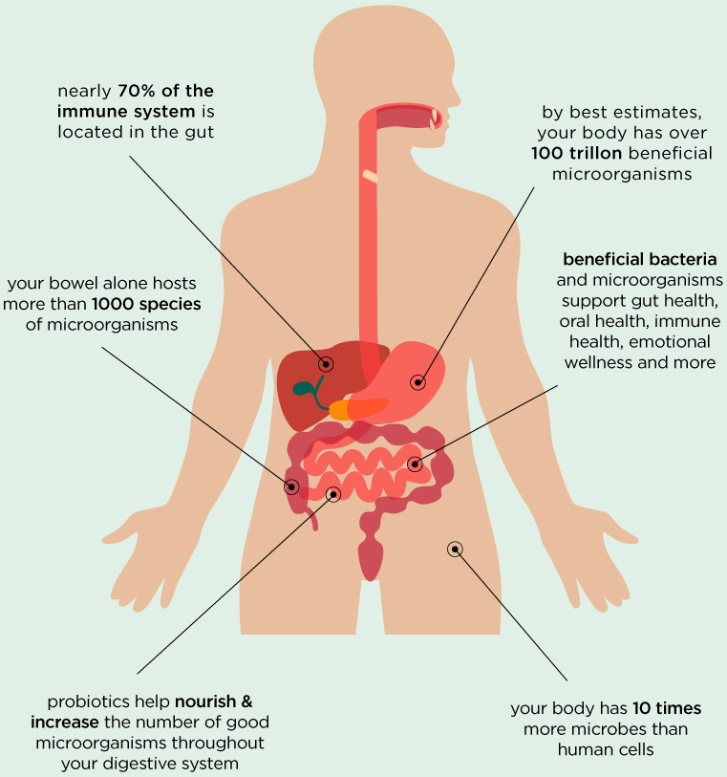
Probiotics
Probiotics are live microorganisms that when administered in adequate amounts can confer a health benefit. They can be found in foods such as yoghurts but also as food supplements. They can help with the following:
digestive issues such as bloating, IBS and antibiotic-associated diarrhea
lactose intolerance
supporting the immune system
There is also new emerging evidence that probiotics can influence the gut-brain axis and improve stress and mood.
The effects of probiotics depend on the properties of the individual strain(s) present. It is important to understand that not all probiotics are the same. Each probiotic is unique – they all act differently and have different effects. It is important to choose a probiotic that is clinically studied and tailored to the health condition (Sanders et al., 2013).

Slide 3
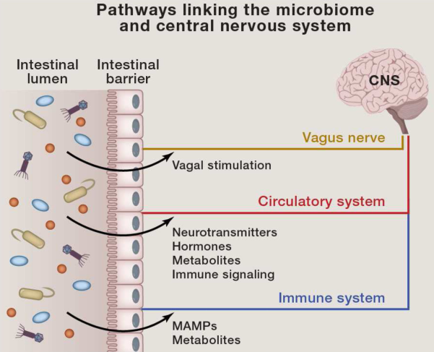
Pathways Linking the Microbiome and Central Nervous System
Signals from the intestinal microbiome may potentially traffic to the central nervous system (CNS) via several mechanisms:
Direct activation of the vagus nerve from the enteric nervous system to the CNS.
Production of or induction of various metabolites that pass through the intestinal barrier and into the circulatory system, where they may cross the blood-brain barrier to regulate neurological function (Abdellatif et al., 2020).
Microbial associated molecular patterns (MAMPs, such as LPS, BLP, and PSA) and metabolites produced by the microbiome can signal to the immune system. Immune cells (and particularly their cytokines) can influence neurophysiology.
Figure 1: Intestinal microbiome interacting with central nervous system.*
*Timothy R. Sampson and Sarkis K. Mazmanian. Control of Brain Development, Function, and Behavior by the Microbiome. Cell Host Microbe, 2015, 17(5), 565–576.

Slide 4
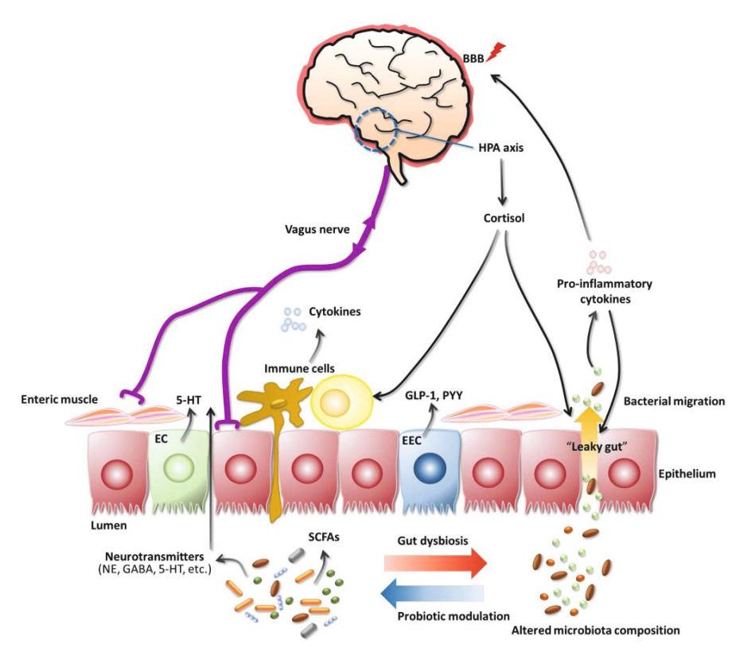
Gut dysbiosis mediated disruption of gut-brain axis
Gut dysbiosis leads to increased inflammation, activation of the HPA (hypothalamuspituitary gland-adrenal gland) axis, and altered levels of neurotransmitters and bacterial metabolites, contributing to abnormal signaling through the vagus nerve.
Reduced integrity of the gastrointestinal barrier triggers bacterial migration (“leaky gut”) and inflammation.
Inflammatory cytokines induce the disruption of blood-brain barrier integrity (Namhee et al., 2018).
Figure 2. Modulation of the gut-brain axis by gut dysbiosis.*
*Namhee Kim, Misun Yun, Young Joon Oh, and Hak-Jong Choi. Mind-altering with the gut: Modulation of the gut-brain axis with probiotics. Journal of Microbiology, 2018, 56(3), 172–182.

Slide 5
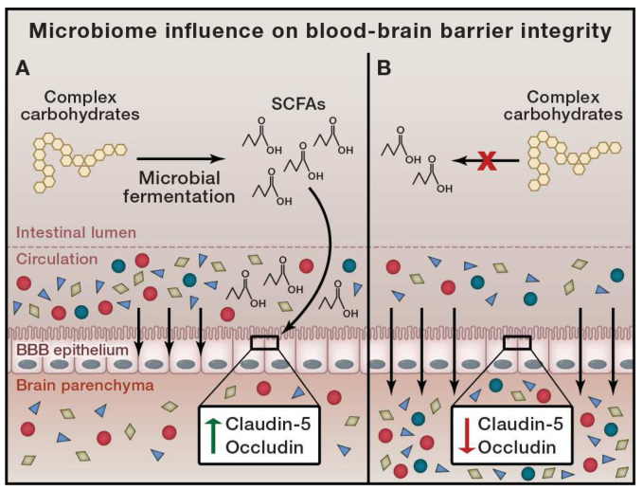
Probiotics and blood-brain barrier
Probiotics are capable of fermenting complex carbohydrates into short chain fatty acids (SCFAs).
The blood-brain barrier (BBB) leads to a tight and selective barrier, preventing undesired metabolites from entering the brain parenchyma.
In the absence of microbial SCFA signaling and tight junction proteins, the permeability of the BBB increases with a loss of selective barrier to serum metabolites.
Figure 3. A) Microbially-produced SCFAs signal to epithelial cells creates BBB and increase production of the tight junction proteins claudin-5 and occludin. B) In the absence of microbial fermentation, no SCFA signaling occurs, and tight junction proteins are repressed.
*Timothy R. Sampson and Sarkis K. Mazmanian. Control of Brain Development, Function, and Behavior by the Microbiome. Cell Host Microbe, 2015, 17(5), 565–576.

Slide 6
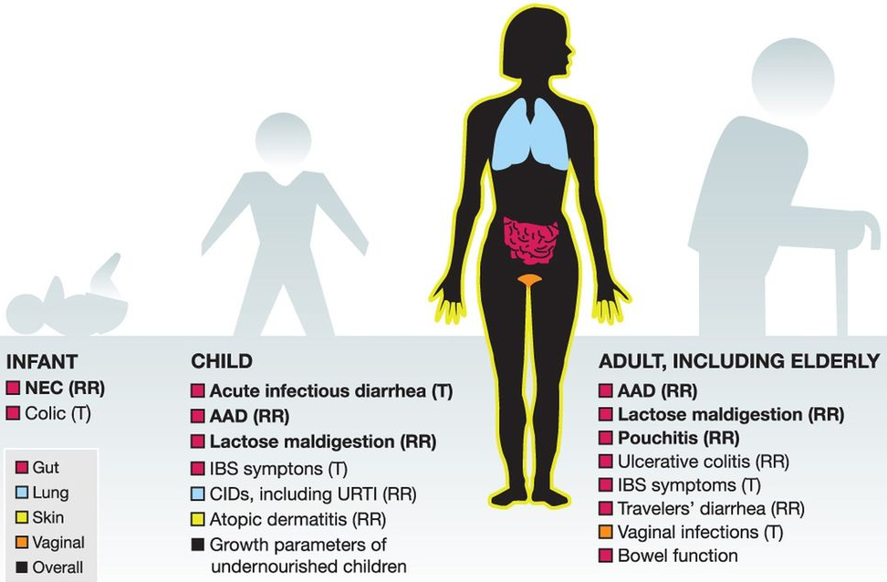
Investigation of probiotics in health and disease
Probiotic administration showed direct or indirect action on the activities and/or populations of gut microbiota and on the intestinal immune system.
Figure 4. A range of health and clinical targets for different probiotics administration over a range of life stages.*
*Sanders ME, Guarner F, Guerrant R, et al. An update on the use and investigation of probiotics in health and disease Gut. 2013, 62:787-796.

Slide 7
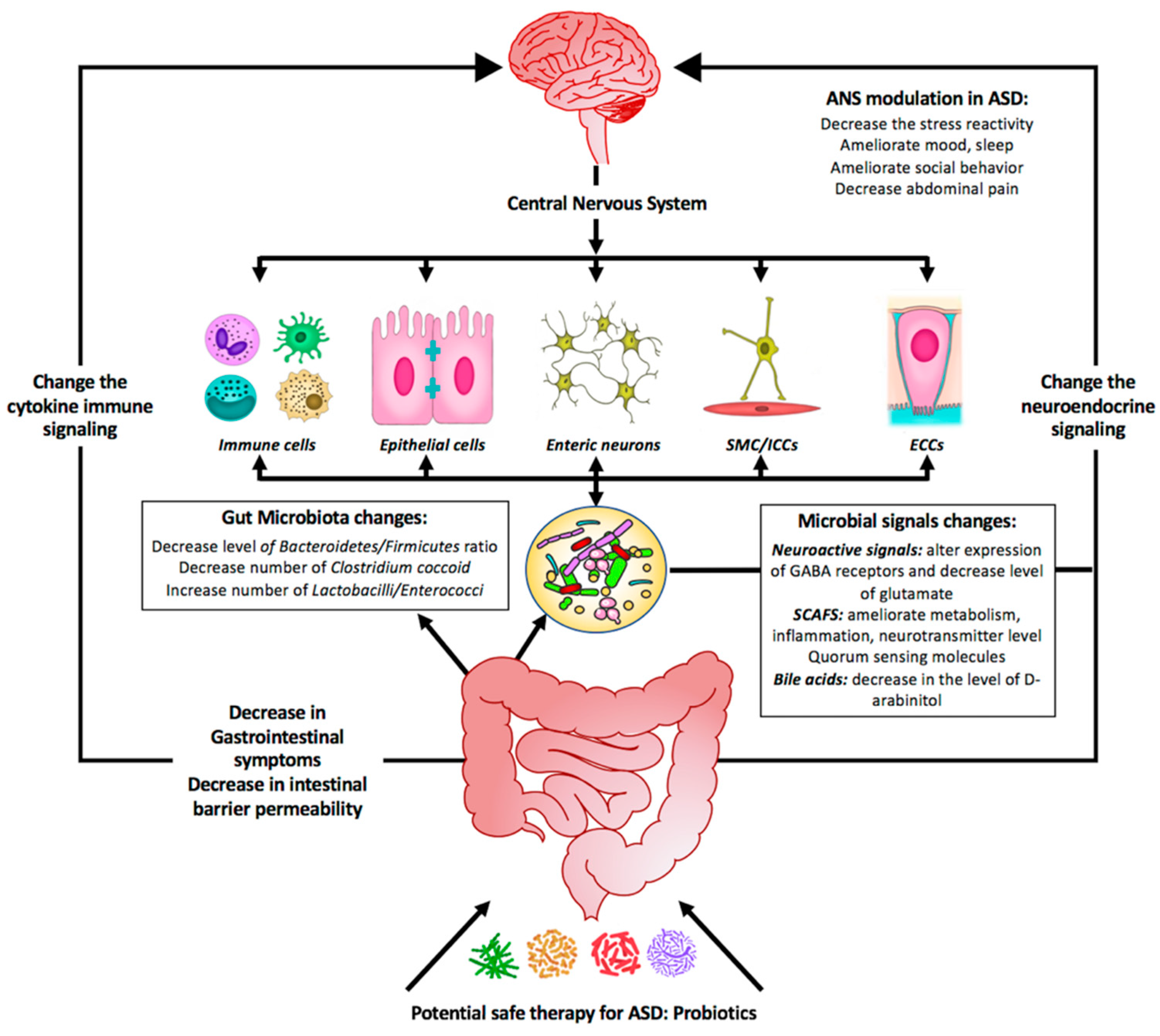
Effect of probiotics in the treatment of ASD symptoms
Figure 5. The effect of probiotics as a potential safe therapy in treating ASD symptoms.*
*Abdellatif B, McVeigh C, Bendriss G, Chaari A. The promising role of probiotics in managing the altered gut in autism spectrum disorders. International Journal of Molecular Sciences. 2020; 21(11):4159.

Slide 8
Yearly work plan
First year objectives
Screening and collection of diseased and healthy individuals
Collection of stool samples, vaginal swabs and breast milk samples of mothers
Collection of stool and saliva samples of infants
DNA extraction and NGS taxonomic analysis
Second year objectives
Biochemical and immunological analysis
Isolation and characterization of probiotic organisms
Evaluation of functional potential of probiotic organisms
Toxicity and pathogenicity testing of isolated organisms
Third year objectives
Investigation of effective mode of probiotic administration
Testing of genetic stability of isolated strains

Slide 9
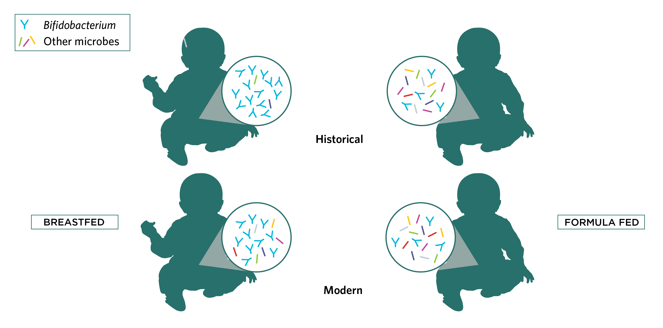
Changes in Infant Microbiome
Alterations in gut microbiota composition may be associated with pathogenesis of various neurological disorders, including stress, autism, depression, Parkinson’s disease, and Alzheimer’s disease.
Gut and brain regulate each other bidirectionally via multiple mechanisms and pathways, including neural, neuroendocrine, and immunological signals.
Therefore, changes in infant microbiome under Autism spectrum disorder (ASD) will show the microbial shifts and metabolic alterations, compared to the milk-fed Infant and other probiotic combinations (Quin et al., 2018).
Healthy child microbiome
ASD child microbiome
Milk-oriented microbiome
Formulated microbiome
Figure 6. Comparison of infant microbiome in different condition.

Slide 10
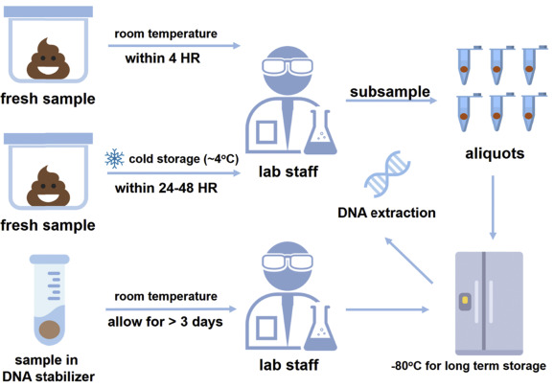
Sample from infant:
Stool sample collection from the infants at approximately 1 week of age and then again monthly until 6 months of age.
Sample collection
Sample from mother:
Stool sample before and after birth of child (within 1 week) and then again monthly until 6 months.
Vaginal swab immediately after birth of child.
Breast milk samples from the mothers for comparisons.
*Samples were excluded if the infant was exposed to antibiotics within 2 weeks of the sample collection date (Li et al., 2018).

Slide 11
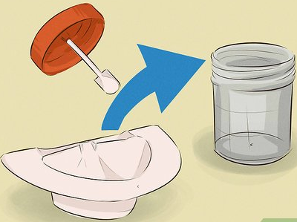
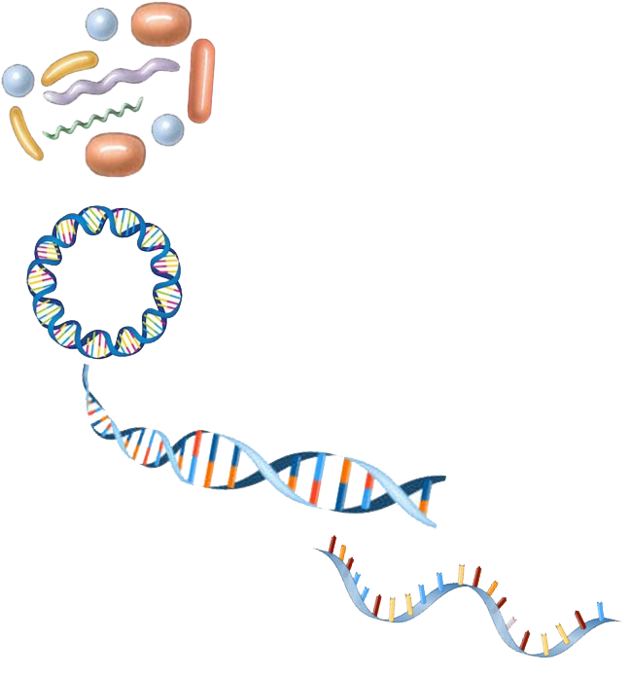
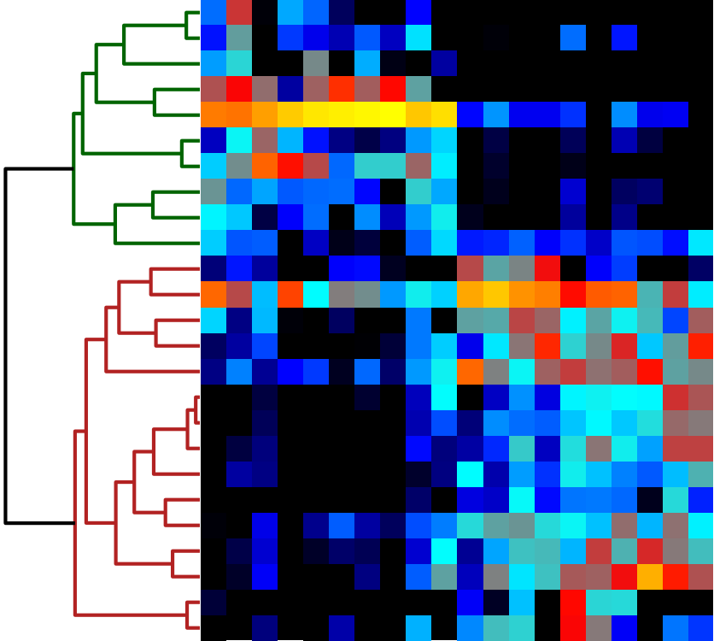
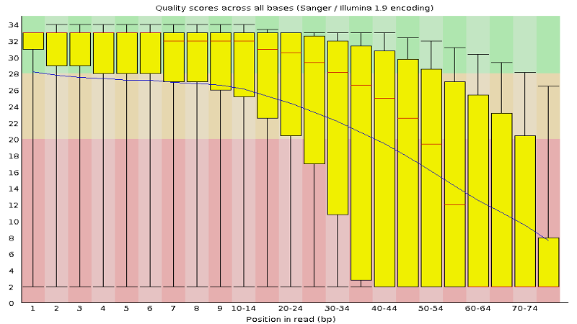
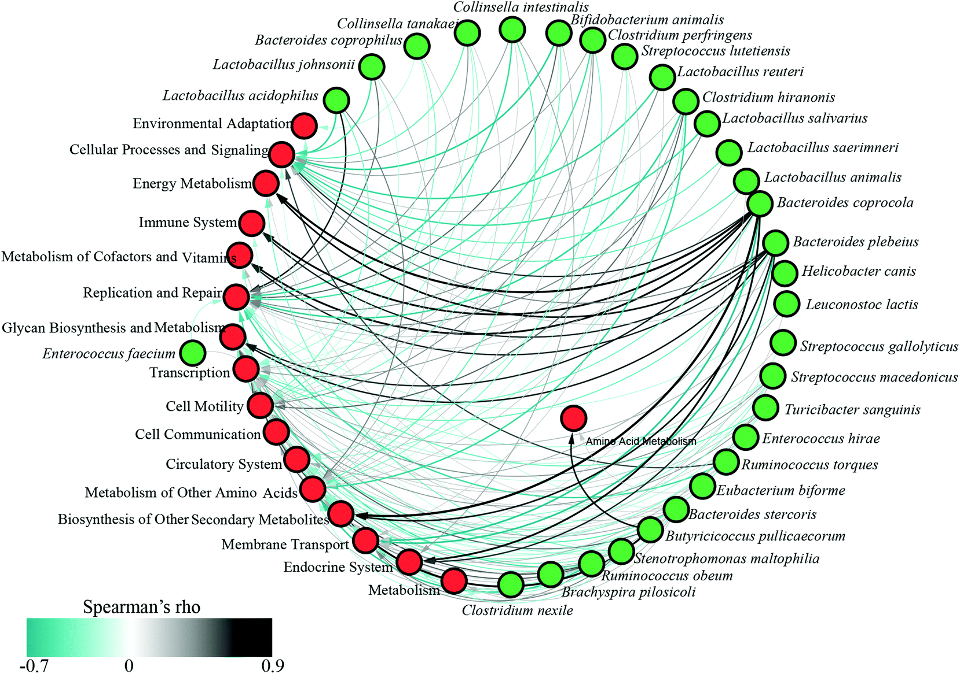
High throughput sequencing and bioinformatic analysis
Shotgun DNA
sequencing
Metagenome
Metagenomic data set
DNA extraction
TACGACGTACGAT
TACGACGTACGATGCTAGCTAATATTTACGCTGCTAGTCGCTCGATGCATCGATCGCATCAGCATCAGCATCAGCATCGACTAGCATCAGCATCGACATCAGCTATATACTCG
TACGACGTACGATTACGACGTACGATGCTAGCTAATATTTACTAGCATCAGCATCGACG
TACGACGTACGATTACGACGTACGATGCTAGCTAATATTTACTAGCATCAGCATCGACG
Sample collection
QC
Microbial species
Assembly-based profiling
(Co)assemble reads into contigs
Preprocessed data set
Taxonomic and functional annotations
Map reads to annotated contigs
Reference information
Read-based taxonomic profiling
Map reads to genomes or marker genes
Available microbial proteins
Genomes and annotations
Annotated pathways
Size: ~ GBs
Read-based metabolic profiling
Map reads to annotated genes,
Proteins or pathways
Bioinformatics software
Metabolic activities
Bacterial strains

Slide 12
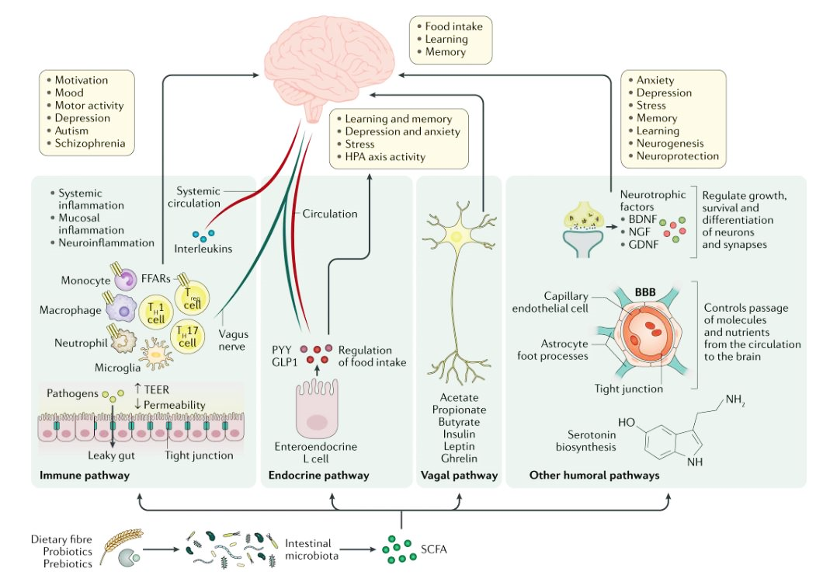
Cytokine analysis
Measurement of sIgA, IgE, and the expression of pro- and anti-inflammatory cytokines (colony-stimulator granulocyte-macrophage colony-stimulating factor (GM-CSF), interferon gamma (IFN-γ), Interleukin (IL)-1β, IL-2, IL-6, IL-8, IL-10, IL-12 (p70), monocyte chemoattractant protein 1 (MCP-1), tumor necrosis factor alpha (TNF-α), IL-13, and IL-5) from whole breast milk and infant stool supernatant at 6 months of age (Quin et al., 2018).
Figure 7. Potential gut–brain pathways through which SCFAs might modulate brain function.

Slide 13
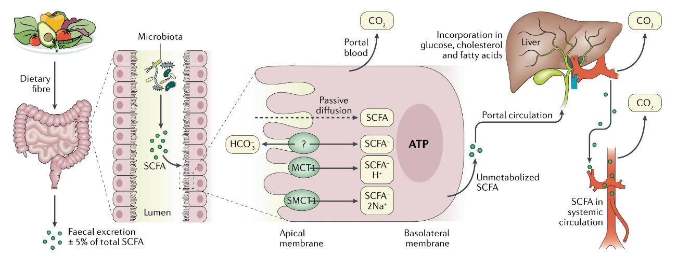
Short-Chain fatty acid analysis
Short-chain fatty acids (SCFAs), the main metabolites produced in the colon by bacterial fermentation of dietary fibers and resistant starch, are speculated to play a key role in neuro-immunoendocrine regulation.
Extraction and analysis of intraluminal SCFA (acetate, butyrate, and propionate) from infants and mothers fecal samples to understand the involvement of SCFAs in microbiota-gut-brain interactions (Estaki et al., 2016).
Figure 8. Metabolism of SCFAs from dietary fiber to systemic circulation.

Slide 14
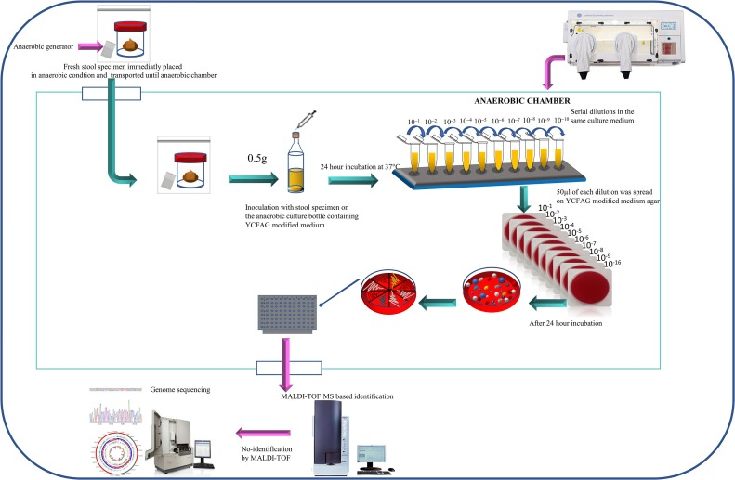
Isolation, identification and cultivation of anaerobic probiotic

Slide 15
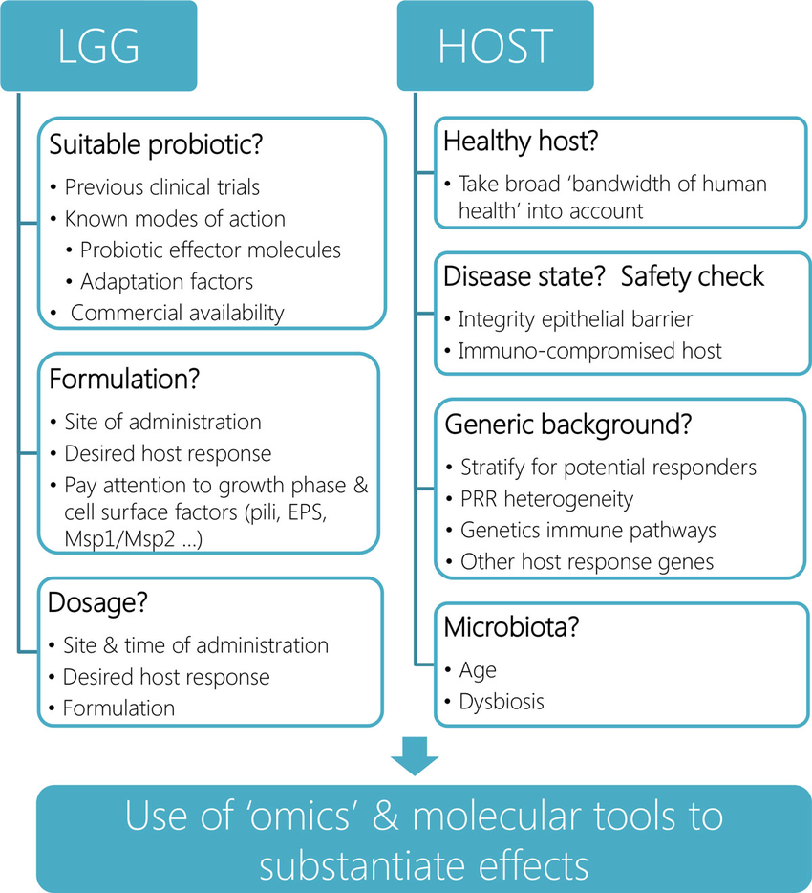
Evaluation of health hazard
Figure 9. Systematic Approach for the Evaluation of Probiotic Safety in Food. DBPC, Double blind, randomized, placebo controlled.

Slide 16
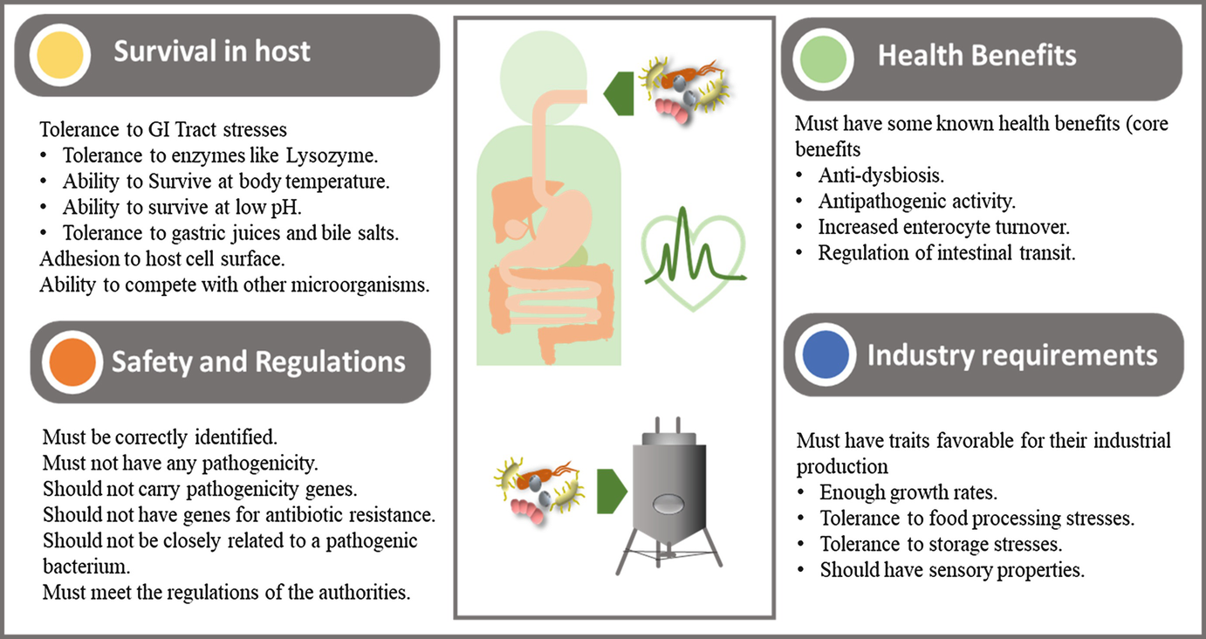
Commercialization of probiotics

Slide 17
References
Abdellatif B, McVeigh C, Bendriss G, Chaari A. The promising role of probiotics in managing the altered gut in autism spectrum disorders. International Journal of Molecular Sciences. 2020; 21(11):4159.
Adams, J.B., Johansen, L.J., Powell, L.D., Quig, D., and Rubin, R.A. Gastrointestinal flora and gastrointestinal status in children with autism-comparisons to typical children and correlation with autism severity. BMC Gastroenterology, 2011, 11, 22.
Aizawa, E., Tsuji, H., Asahara, T., Takahashi, T., Teraishi, T., Yoshida, S., Ota, M., Koga, N., Hattori, K., and Kunugi, H. Possible association of Bifidobacterium and Lactobacillus in the gut microbiota of patients with major depressive disorder. Journal of Affective Disorders, 2016, 202, 254–257.
Cohen, L.J., Esterhazy, D., Kim, S.H., Lemetre, C., Aguilar, R.R., Gordon, E.A., Pickard, A.J., Cross, J.R., Emiliano, A.B., Han, S.M., et al. Commensal bacteria make GPCR ligands that mimic human signaling molecules. Nature, 2017, 549, 48–53.
Estaki M, et al. Cardiorespiratory fitness as a predictor of intestinal microbial diversity and distinct metagenomic functions. Microbiome. 2016, 4(1), 42.
Furusawa, Y., Obata, Y., Fukuda, S., Endo, T.A., Nakato, G., Takahashi, D., Nakanishi, Y., Uetake, C., Kato, K., Kato, T., et al. Commensal microbe-derived butyrate induces the differentiation of colonic regulatory T cells. Nature, 2013, 504, 446–450.
Li N, et al. Correlation of gut microbiome between ASD children and mother and potential biomarkers for risk assessment. 2018, 17(1), 26-38.
Namhee Kim, Misun Yun, Young Joon Oh, and Hak-Jong Choi. Mind-altering with the gut: Modulation of the gut-brain axis with probiotics. Journal of Microbiology, 2018, 56(3), 172–182.
Quin C, Estaki M, et. al. Probiotic supplementation and associated infant gut microbiome and health: a cautionary retrospective clinical composition. 2018, 8, 8283.
Sanders ME, Guarner F, Guerrant R, et al. An update on the use and investigation of probiotics in health and disease. Gut. 2013, 62:787-796.
Timothy R. Sampson and Sarkis K. Mazmanian. Control of Brain Development, Function, and Behavior by the Microbiome. Cell Host Microbe, 2015, 17(5), 565–576.

